Slide 1
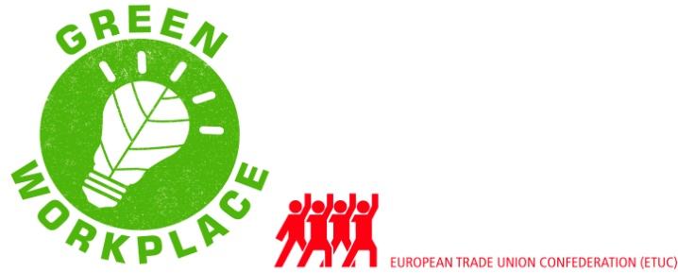
Pushing forward workers’ rights to put Just Transition into action at the workplace and achieve EU targets. Example Arbeid & Milieu: Umicore < > Tessenderlo Group Jorre Van Damme | coördinator | Arbeid & Milieu vzw | Flanders, Belgium e-mail: jorre.van.damme@a-m.be
ETUC-CES Closing Conference
Green workplace Representatives Project – 9th Oct 2012
Brussels, Belgium

Slide 2
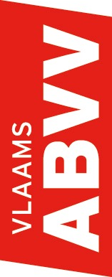
Pushing forward workers’ rights
Example Arbeid & Milieu
Tweekerkenstraat 47
1000 Brussel
02/ 325 35 00
www.a-m.be
secretariaat@a-m.be
Making the case for proactive union involvement
WHAT?
Looking at 2 companies, meeting similar challenges
Umicore - metals, has ample experience adapting to huge environmental and economical challenges
Tessenderlo Group - chemicals, undergoing a top-down (management induced) transition towards a more environmentally durable company
WHY?
Taking lessons learned from Umicore history to inspire union response to
changes at Tessenderlo Group... and probably many others to come!
WHO?
Delegate(s) and secretary for ABVV at Umicore
Kris Engelen, head union delegate for ACV at Tessenderlo Chemie
Eddy Kellens, union secretary for ACV
With financial support of the European Commission

Slide 3
Pushing forward workers’ rights
Example Arbeid & Milieu
Tweekerkenstraat 47
1000 Brussel
02/ 325 35 00
www.a-m.be
secretariaat@a-m.be
Case 1: Umicore
COMPANY HISTORY
Former Union Minière Group
Almost bankrupt in mid-90’s
Notorius polluter, situated within urban area (Hoboken, Antwerp)
unsustainable situation!
New Industrial Plan implemented 1995 to 1999 = heavy restructuring
New activities, new markets, new technologies: recycling precious metals (now nr. 1 for recycling batteries for hybrid/electric cars)
Environmental overhaul: cleaning up historical pollution, focus on environmentally and economically durable activities
With financial support of the European Commission

Slide 4
Pushing forward workers’ rights
Example Arbeid & Milieu
Tweekerkenstraat 47
1000 Brussel
02/ 325 35 00
www.a-m.be
secretariaat@a-m.be
Case 1: Umicore
LESSONS LEARNED
Sudden nature of restructuring meant undesirable outcomes
for workers
workforce diminished by 25% (including early retirement and outplacement); more flexibility; less pay; sudden transfers to other posts; health and safety issues due to sudden implementation of new processes and technology
for the company
high economic risk, loss of expertise (elderly workers leaving)
for society
externalisation of internal problems by company is carried by whole society (e.g. unemployment, early retirement, ...)
During and after restructuring, programmes for (re)training and health & safety measures were put in place, hiring people again, but...
damage was done
With financial support of the European Commission

Slide 5
Pushing forward workers’ rights
Example Arbeid & Milieu
Tweekerkenstraat 47
1000 Brussel
02/ 325 35 00
www.a-m.be
secretariaat@a-m.be
Case 2: Tessenderlo Group
COMPANY AND AMBITIONS
Operating worldwide, started from Tessenderlo, Belgium
Activities: gelatines, bio-fuels, PVC, fertilizers, ...
New CEO Frank Coenen wants the company to focus only on activities that are ecologically durable and less sensitive to economic crisis
(UMICORE) HISTORY REPEATED?
middle management not “socialized” in ecological issues → replaced instead of retrained (?)
divisions of the group that do not fit the new ecological ambitions and economic standards are sold / closed instead of reoriented
= externalising internal problems
With financial support of the European Commission

Slide 6
Pushing forward workers’ rights
Example Arbeid & Milieu
Tweekerkenstraat 47
1000 Brussel
02/ 325 35 00
www.a-m.be
secretariaat@a-m.be
Case 2: Tessenderlo Group
QUESTIONS TO BE ASKED
Can we avoid the same undesired outcomes for workers, company and society as we’ve seen with the Umicore case?
Many more companies will (have to) face the same challenges → what if they all – individually – externalised their internal problems within a relative short timespan?
Allowing all individual companies to externalise their internal problems when changing (for the better), will make the much needed transition to an ecologically, economically and socially durable economy unachievable at the macro-level !
With financial support of the European Commission

Slide 7
Pushing forward workers’ rights
Example Arbeid & Milieu
Tweekerkenstraat 47
1000 Brussel
02/ 325 35 00
www.a-m.be
secretariaat@a-m.be
Case 2: Tessenderlo Group
MORE (PROACTIVE) UNION INVOLVEMENT AT AN EARLIER STAGE IS NEEDED IN TRANSITIONS AT THE COMPANY LEVEL TO MINIMISE THE COSTS OF CHANGE
for workers involved
for society as a whole
Issues now to be looked at by unions at company level:
how to avoid negative impact of changes on health and safety
how to retrain as much as possible instead of fire-and-hire strategy
outplacement (to another job in another company) is an option, but not with the worker’s back against the wall
→ Involve workers through unions in early stages of change and do not await the crisis-moment
With financial support of the European Commission

